Slide 1
Employee churn analysis
DA4204-Ihsan Karaosmanoglu

Slide 2




Solution Process
EDA
Cluster Analysis
Predictive Model Building
Model Deployment

Slide 3
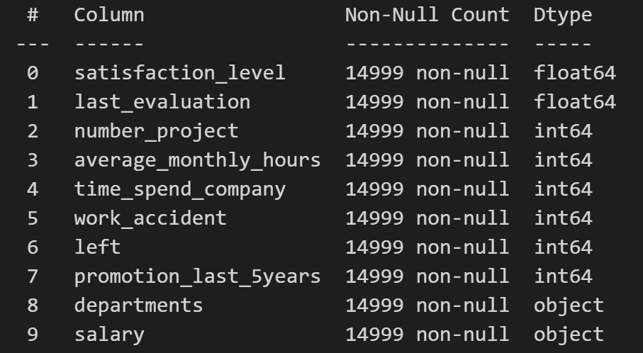
DATASET
Dataset includes level of satisfaction, evaluated performance, number of projects assigned, average monthly hours, years spent in the company, whether they had any work accident or not, if they received any promotion in the last five years, their department, salary level, and most importantly, whether the employee has left the company or not.

Slide 4
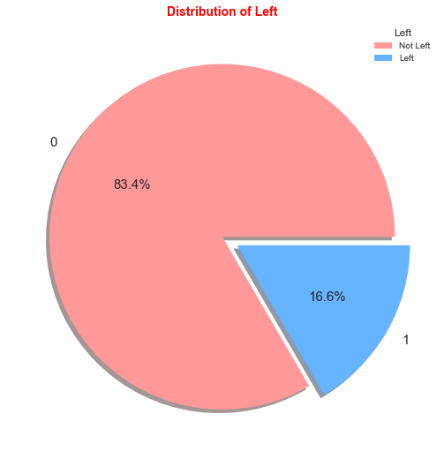
Problem
Employee Churn
Imbalanced Data
Significant impact on organization's productivity, morale, and overall operational continuity.
Understand and predict employee churn.
This can significantly skew the predictive model's performance.
It can lead to overfit towards the majority class
17% of Employees Parted Ways
Almost 83% of the employees preferred to continue with the company and stayed.
10000 employees stayed.

Slide 5
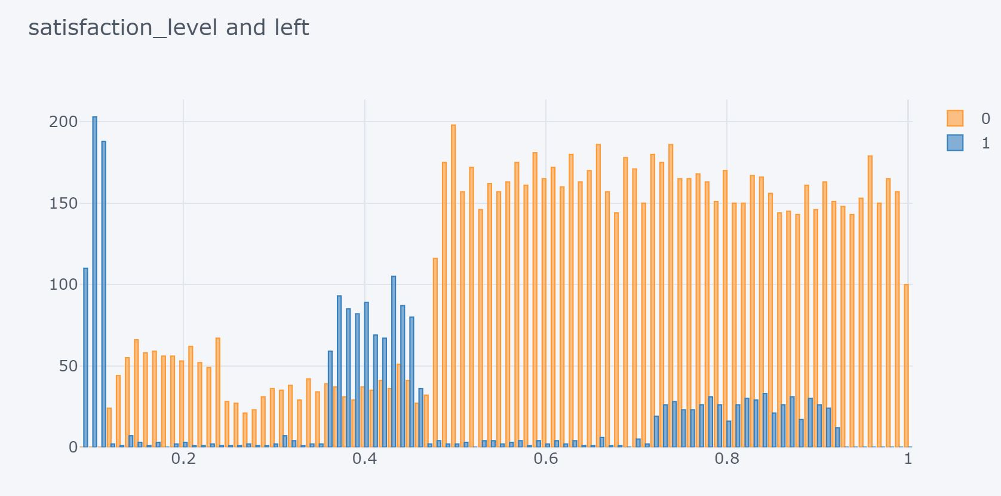
Satisfaction Level and Left
Complex relationship between these two features
Between 0.7 and 0.9 satisfaction levels there is an increase in the number of those who left the company

Slide 6
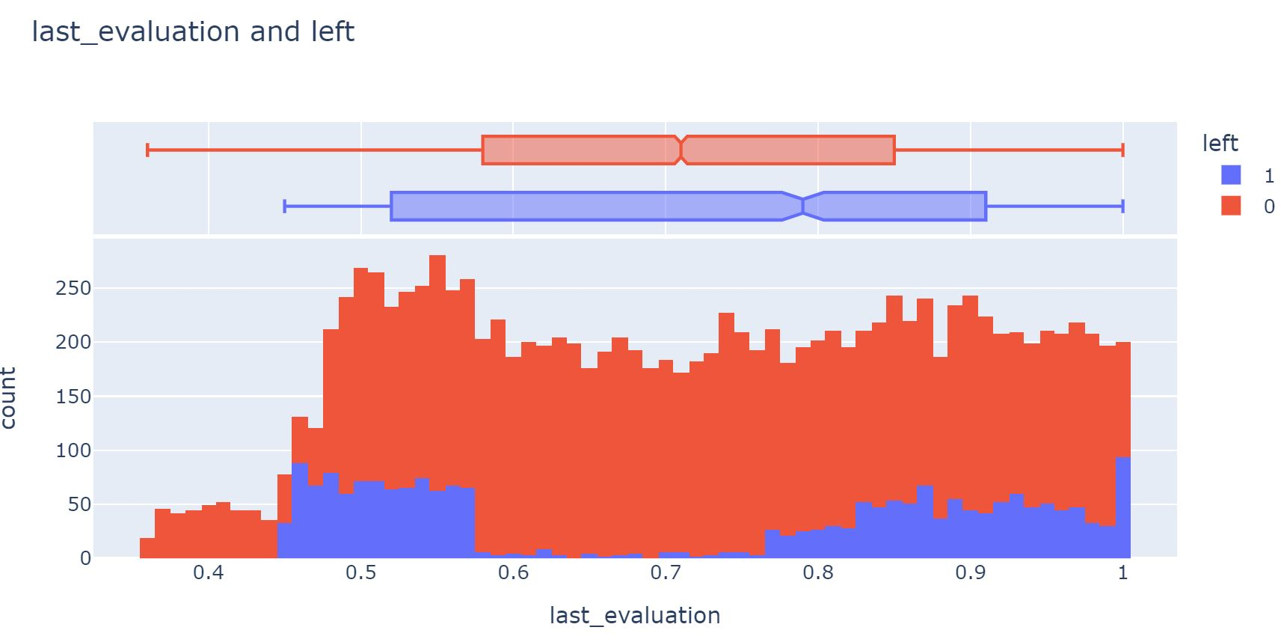
Last Evaluation and Left
Increase in the ranges of 0.45-0.6 and 0.8-1
Both intervals of low to moderate scores and high scores saw an uptick in churn.

Slide 7
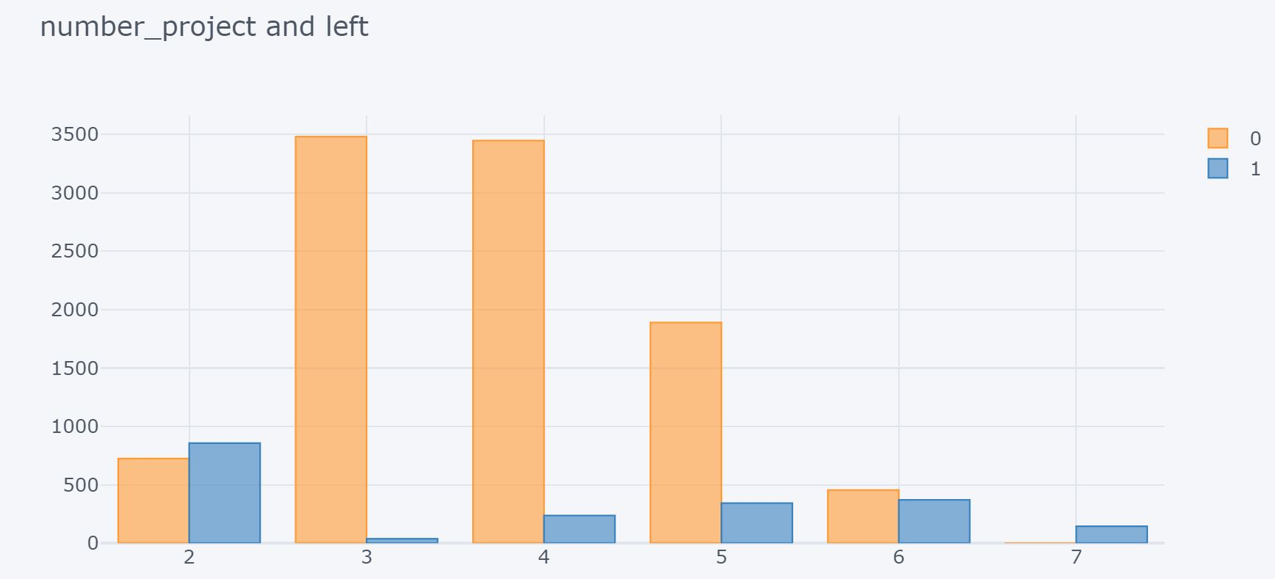
Number of Project and Left
Employees who have completed 2, 6, and 7 projects are more prone to leave the company
Trend is the increased likelihood to leave among employees who have completed only 2 projects

Slide 8
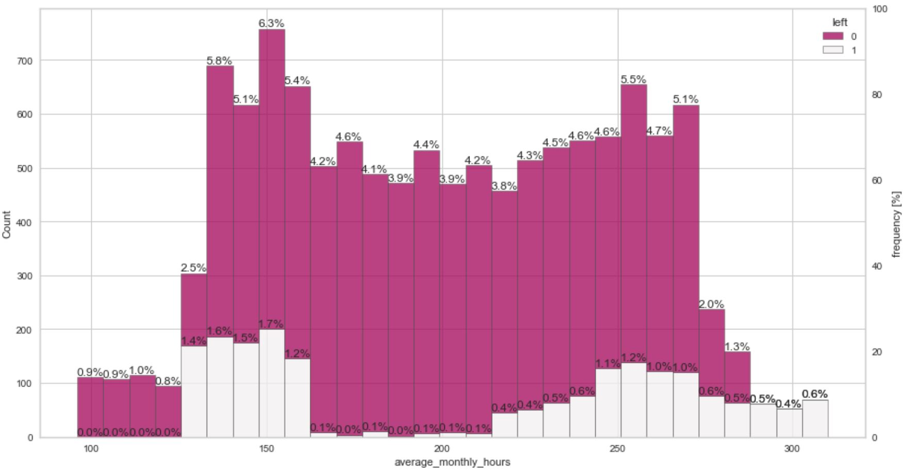
Average Monthly Hours and Left
The first phase; less than 125 hours per month.
The second phase; 125 to 160 hours per month.
The third phase; 160 to 220 hours per month.
The fourth phase; 220 to 288 hours per month.
The fifth phase; more than 288 hours per month.

Slide 9
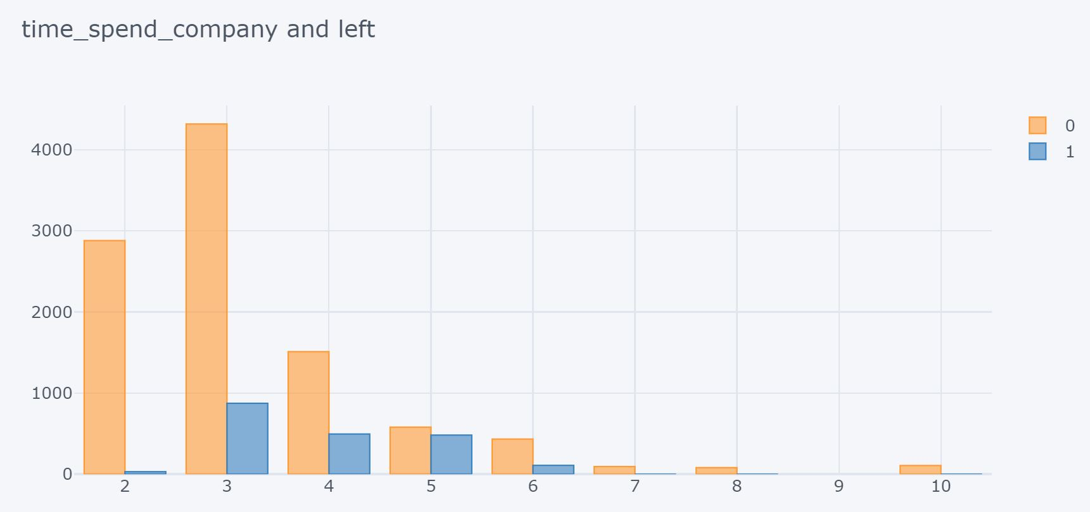
Time Spend in the Company and Left
Employee churn peaks in the third year of employment.
Gradually decreases until the sixth year.

Slide 10
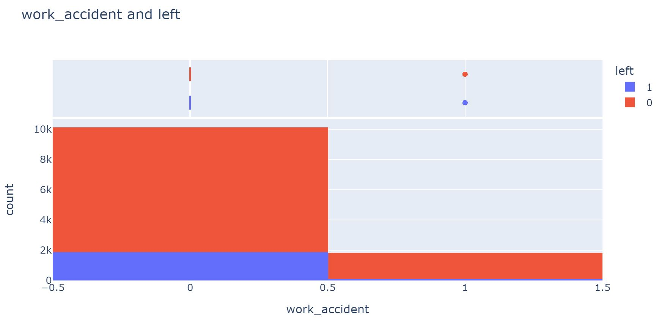
Work Accident and Left
Employees who have not had a work accident appear to be more likely to leave, with a churn rate of 22.84%.
Employees who have had a work accident show a lower churn rate of 6.02%.
It might seem counterintuitive, it's important to consider the potential reasons behind this.

Slide 11
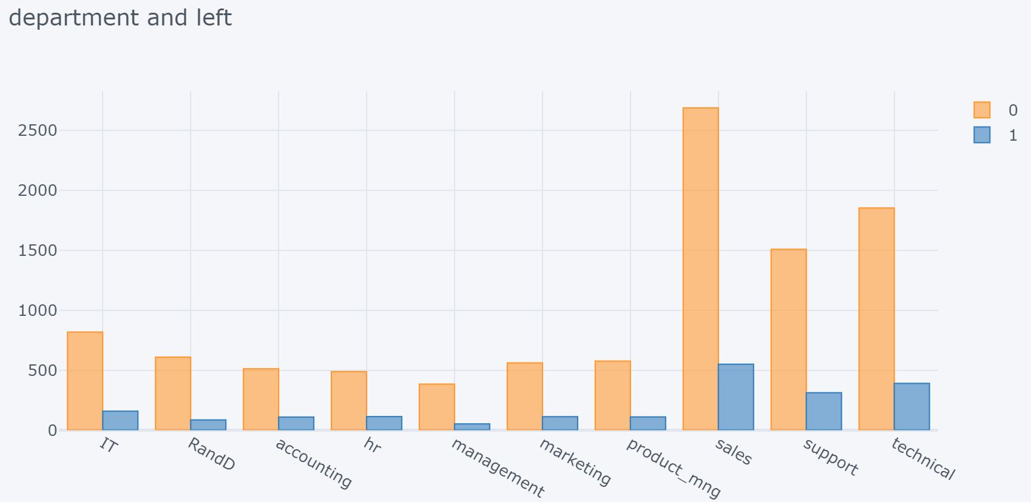
Department and Left
There is no significant correlation between the department an employee works in and their likelihood to leave the company.
Reasons for employee churn are more personal and less influenced by the broader organizational context.

Slide 12
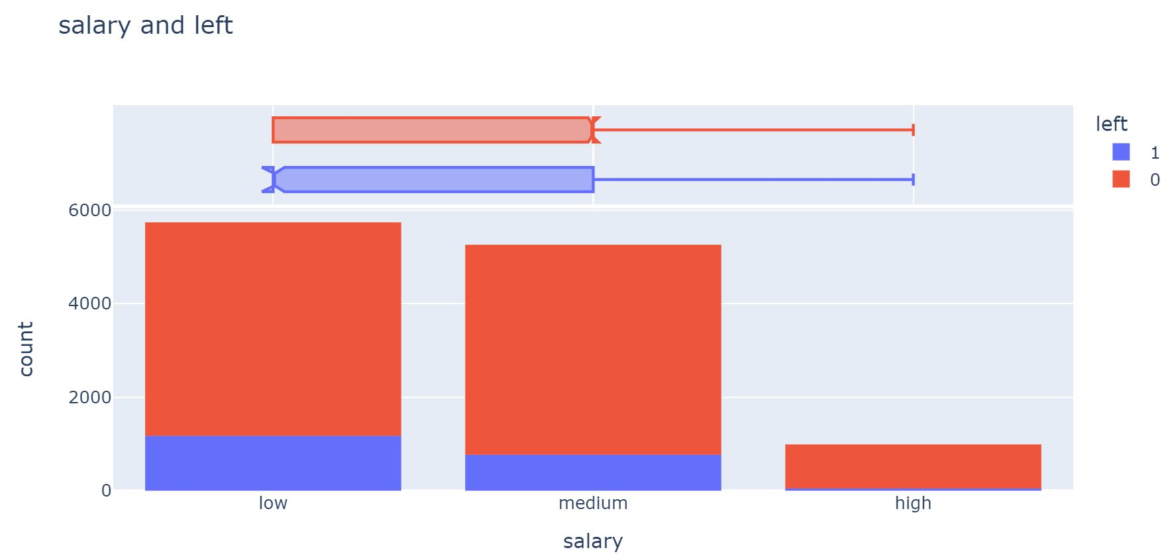
Salary and Left
As salary levels rise, we see a corresponding decrease in the churn rate.
Data shows that as we move from low to medium to high salary levels, there is a respective decrease in employee churn

Slide 13
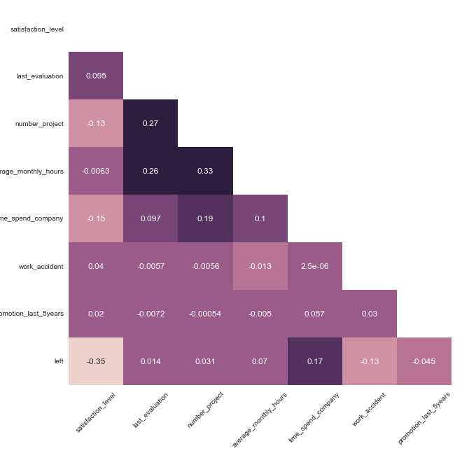
OVERALL EXAMINATION
There is no multicollinearity problem among our features.
Weak level correlations between the numerical features and the target column.
'satisfaction_level' had the most significant influence on the decision to leave.
Time spent at the company positively influences the decision to leave.

Slide 14
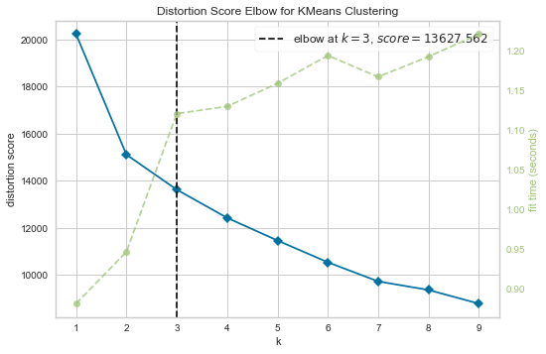

Elbow method for k-means
Number of Clusters
Determined optimal number of clusters as three.

Slide 15
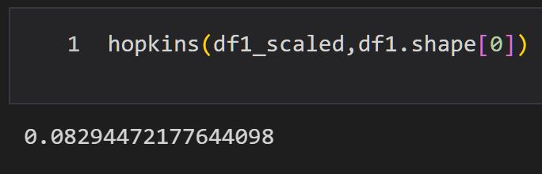
Hopkins statistic
Calculated a Hopkins score of approximately 0.083.
It is an excellent preliminary indicator that applying a clustering algorithm to our data will yield insightful results.

Slide 16
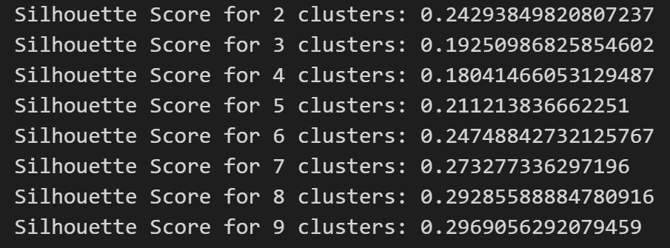
Silhouette scores

Slide 17



Predictive modelling
Import PyCaret
Analyse the Results
Continue With the Best Algorithm​
Open-source, low-code machine learning library in Python that allows us to compare multiple models
Compare over ten machine learning and deep learning models
The Light Gradient Boosting Machine, or LightGBM, emerged as the top-performing model with an accuracy of 0.9829 and an AUC of 0.9836.

Slide 18
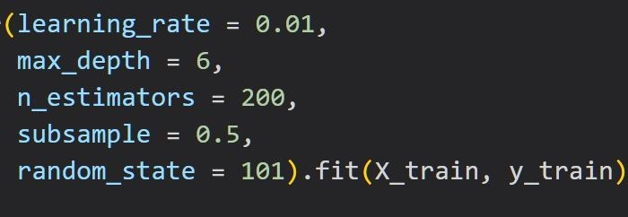
MODEL tuning
Learning rate
Train data
A
N_estimators
Max depth
D
B
C
E
subsample​

Slide 19
Model COMPARISON
LIGHTGBM VS TUNED | Precision | Recall | F1-SCORE | SUPPORT
LightGBM | ​ | ​ | ​
0 | 0.99 | 0.99 | 0.99 | 3001
1​ | ​0.95 | 0.92​ | 0.94 | 597
Accuracy​ |  |  | 0.98 | 3598​
Macro Average​ | 0.97 | 0.96 | 0.96 | 3598​
Weighted average​ | 0.98 | 0.98 | 0.98 | 3598
LightGBM Tuned | ​ | ​ | ​ | ​
0 | 0.99 | 0.99 | 0.99 | 6999
1 | 0.97 | 0.93 | 0.95 | 1394
Accuracy |  |  | 0.98 | 1394
Macro Average | 0.98 | 0.96 | 0.97 | 8393
Weighted average | 0.98 | 0.98 | 0.98 | 8393

Slide 20
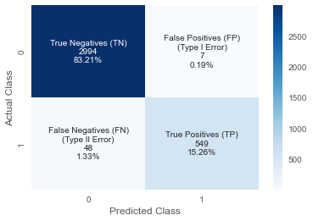
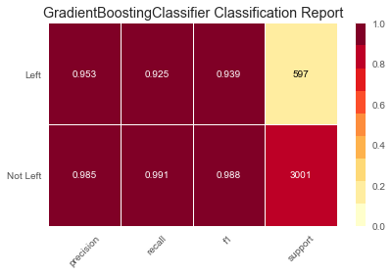
Evaluating model
LIGHTGBM Tuned
Model Performance
Classification Report

Slide 21

Model DEPLOYMENT
Next step
We will move to a new .py file where we will employ Streamlit to create our web application. This application will serve as the interface for our work, allowing users to interact with our model, input data, and receive predictions in real-time.

Slide 22
Summary
Our journey today has seen us through each step of a data science project, from understanding the data, analyzing it, building a predictive model, fine-tuning that model, and finally deploying it. It has been an enriching experience, filled with valuable insights and learning.

Slide 23
Thank you
Ihsan Karaosmanoglu​​
You can find open-source code of this project on my GitHub account: github.com/ihsankoo

